Slide 1

INSTITUTE : UIE
DEPARTMENT : CSE
Bachelor of Engineering (Computer Science & Engineering)
PROJECT BASED LEARNING IN JAVA
(20CST-319/20ITT-319)
TOPIC OF PRESENTATION:
Difference between method overloading and method overriding.
DISCOVER . LEARN . EMPOWER

Slide 2

Lecture Objectives
In this lecture, we will discuss:
Difference between method overloading and method overriding.

Slide 3
Method Overriding
If subclass (child class) has the same method as declared in the parent class, it is known as method overriding in Java.
Method with the same name, arguments and return type in both the parent and the child class
If an overridden method is called from subclass object , it will always refer to the version defined by the subclass
Need to Override– If a sub class needs have a different method implementation from that of a super class

Slide 4
Usage of Java Method Overriding
Method overriding is used to provide the specific implementation of a method which is already provided by its superclass.
Method overriding is used for runtime polymorphism
Rules for Java Method Overriding
The method must have the same name as in the parent class
The method must have the same parameter as in the parent class.
There must be an IS-A relationship (inheritance).

Slide 5
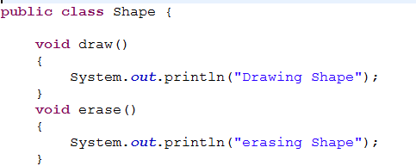
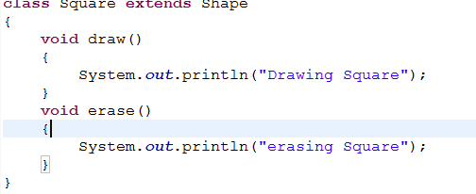
Method Overriding
Draw() and erase() in Base Class
Draw() and erase() in Derived Class

Slide 6
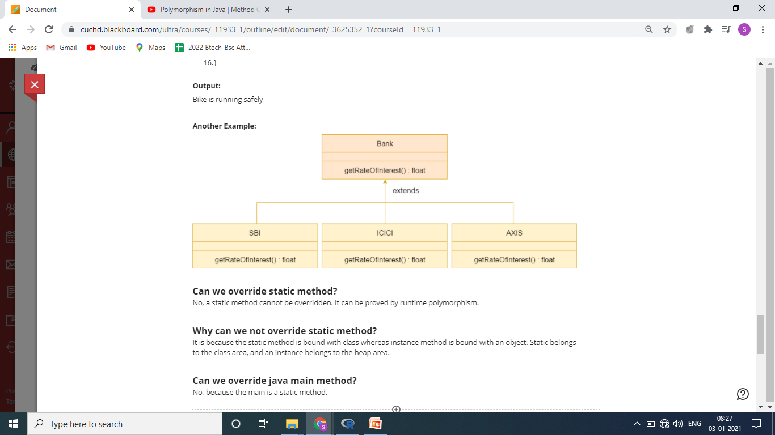
Method Overriding

Slide 7
Dynamic Method Dispatch or Runtime Polymorphism
Basis of one of Java’s most powerful concepts: dynamic method dispatch
Dynamic method dispatch occurs when the Java language resolves
a call at runtime
Runtime polymorphism is possible in java using
– superclass reference variables
– overridden methods

Slide 8
Method Overloading
Method Overloading in Java
If a class has multiple methods having same name but different in parameters, it is known as Method Overloading.
If we have to perform only one operation, having same name of the methods increases the readability of the program.
Allows to define the method with the same name but either return type or arguments list should be different
Class BasicCalculator{
Void sum(int a,int b){
System.out.println(a+b);
}
void sum(int a,int b,int c){
System.out.println(a+b+c);
}

Slide 9
Advantage of method overloading
Method overloading increases the readability of the program.
Different ways to overload the method
There are two ways to overload the method in java
By changing number of arguments
By changing the data type

Slide 10
Q) Why Method Overloading is not possible by changing the return type of method only?
In java, method overloading is not possible by changing the return type of the method only because of ambiguity. Let's see how ambiguity may occur:
class Adder{
static int add(int a,int b){return a+b;}
static double add(int a,int b){return a+b;}
}
class TestOverloading3{
public static void main(String[] args){
System.out.println(Adder.add(11,11));//ambiguity
}}
Output:
Compile Time Error: method add(int,int) is already defined in class Adder
System.out.println(Adder.add(11,11)); //Here, how can java determine which sum() method should be called?

Slide 11
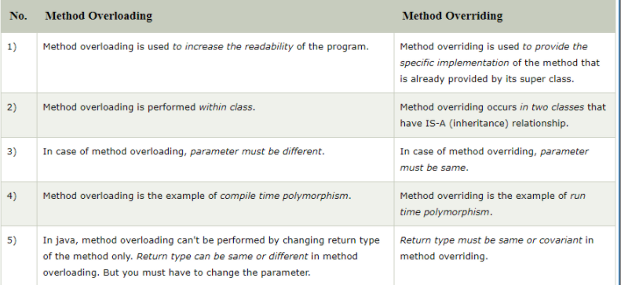

Slide 12
QUIZ:
What is the process of defining two or more methods within same class that have same name but different parameters declaration? a) method overloading b) method overriding c) method hiding d) none of the mentioned
What is the process of defining a method in terms of itself, that is a method that calls itself? a) Polymorphism b) Abstraction c) Encapsulation d) Recursion

Slide 13
Summary:
In this session, you were able to :
• Learn about Difference between method overloading and method overriding.

Slide 14
References:
Books:
1. Balaguruswamy, Java.
2. A Primer, E.Balaguruswamy, Programming with Java, Tata McGraw Hill Companies
3. John P. Flynt Thomson, Java Programming.
Video Lectures :
https://www.youtube.com/watch?v=RaAp-f2Np1U
https://youtu.be/9OXXbQBesHg
Reference Links:
https://www.javatpoint.com/method-overloading-in-java
https://www.javatpoint.com/method-overriding-in-java
https://www.javatpoint.com/method-overloading-vs-method-overriding-in-java
https://www.geeksforgeeks.org/overloading-in-java/
https://www.journaldev.com/16807/method-overloading-in-java

Slide 15
THANK YOU

